Slide 1
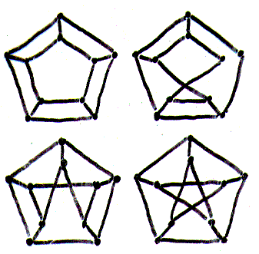
Graph Theory
Lec-17

Slide 2

Can you draw the above figure in one continuous trace with no line being drawn twice?

Slide 3

How about this one?

Slide 4
Definitions:
A graph is connected if it is possible to walk from any vertex to any other vertex.
Two nodes (vertices) are adjacent if there is at least one edge between them.
The degree of a vertex is the number of edges emanating from it.
adjacent
This node has degree 5.
Note: Each loop counts as two edges emanating from a node.
connected graph

Slide 5
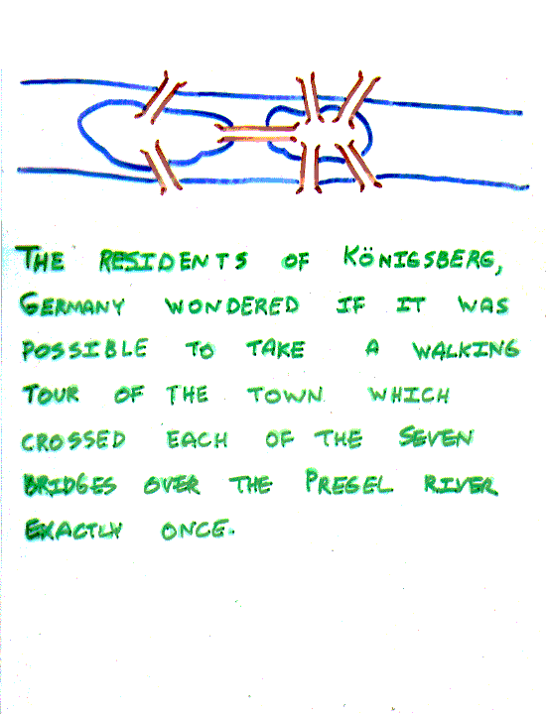
Picture only what is essential to the problem.
The residents of Königsberg, Germany, wondered if it was possible to take a walking tour of the town that crossed each of the seven bridges over the Presel river exactly once.

Slide 6
Is it possible to start at some node and take a walk that uses each edge exactly once, and ends at the starting node?

Slide 7
1
Original:
2
3
4
Redrawn:
2
4
1
3
You can redraw the original picture as long as for every edge between nodes i and j in the original you put an edge between nodes i and j in the redrawn version (and you put no other edges in the redrawn version).

Slide 8
Has no tour that uses each edge exactly once.
(Even if we allow the walk to start and finish in different places.)
Can you see why?
Leonard Euler 1736 proved it
(father of graph theory)

Slide 9
A walk in a graph is called an Euler tour if it starts and ends in the same place and uses each edge exactly once.
A walk in a graph is called an Euler trail if it uses each edge exactly once.
If a graph has an Euler tour, it is said to be an Eulerian graph.

Slide 10
The problem in our language:
Show that is not Eulerian.
In fact, it contains no Euler trail.

Slide 11
Theorem (Euler):
1. A connected graph G is Eulerian

G is connected and has no vertices of odd degree
2. A connected graph G is has an Euler trail from node a to some other node b

G is connected and a ≠ b are the only two nodes of odd degree

Slide 12
A directed graph is a graph where each edge is directed from one of its endpoints to the other.
Example:
Exercise: If a directed graph G has the property that
# of edges leaving a node =
# of edges coming in
Then G has a directed Eulerian tour.

Slide 13
A graph has a Hamiltonian tour if there is a tour that visits every vertex exactly once (and returns to its starting point).
A graph with a Hamiltonian tour is called a Hamiltonian graph.

Slide 14
Yes.
A graph of the vertices of a dodecahedron.
Is it Hamiltonian?

Slide 15
This one has a Hamiltonian path, but not a Hamiltonian tour.
This one has an Euler tour, and Hamiltonian path.

Slide 16
Given a graph, what is a fast way to determine if it is Hamiltonian?
Can we give a characterization of Hamiltonian graphs that is as simple as the one for Eulerian graphs?

Slide 17
No one knows. Deciding if a graph is Hamiltonian is NP−complete.
There is probably no nice characterization of Hamiltonian graphs the way there was with Eulerian graphs.

Slide 18
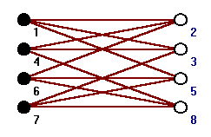
Bipartite Graphs
A bipartite graph is a graph G whose vertex set V can be partitioned into two non empty sets V₁ and V₂ in such a way that every edge of G joins a vertex in V₁ to a vertex in V₂.
An alternative way of thinking about it is coloring the vertices in V₁ one color and those in V₂ another color. Then adjacent vertices would have different colors.

Slide 19
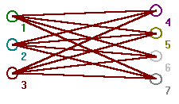
Bipartite Graphs
If V₁ has r vertices and V₂ has s vertices then the complete bipartite graph is written as K_{r,s}.
If in a bipartite graph G with V₁ and V₂ as above we have that every vertex in V₁ is adjacent to every vertex in V₂ then G is a complete bipartite graph.
The graph K_{3,4}

Slide 20
Examples: Bipartite Graphs
Graph between courses and class rooms. Application?
Graph between documents and keywords. Application?
Graph between cars and parking slots.

Slide 21
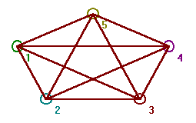
Complete Graph
A complete graph is a graph where every pair of distinct vertices are adjacent. A complete graph on n vertices is denoted by K_{n} (or sometimes by K(n) ). So, for example, the figure shows a graph K₅.
The Graph K₅

